Slide 1
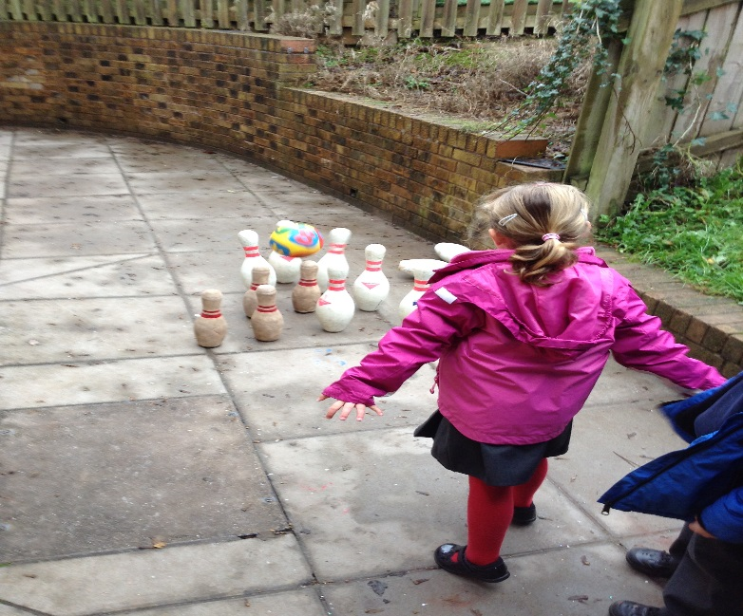
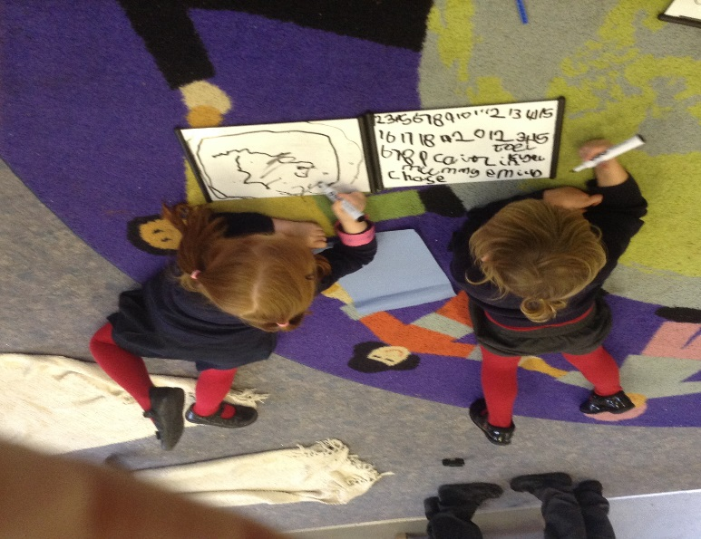
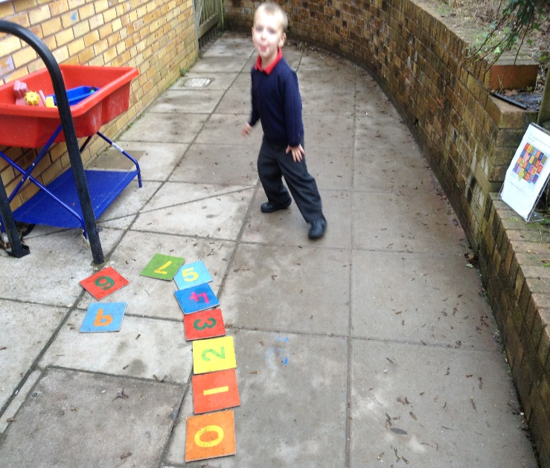
Maths Workshop 12th October 2019
Number

Slide 2
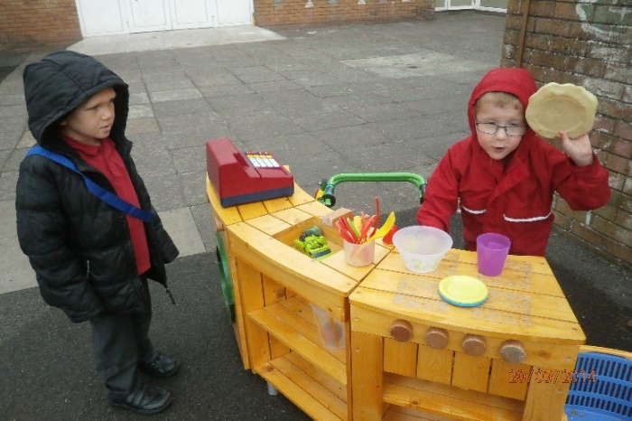
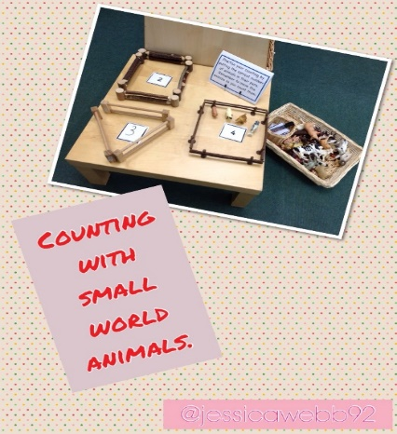
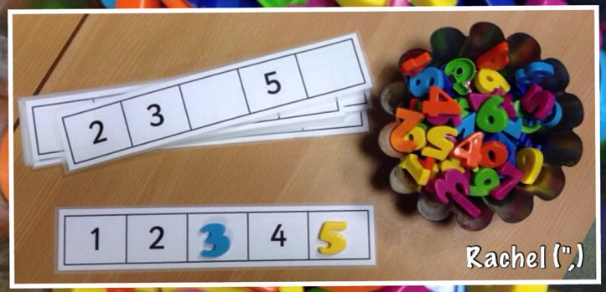
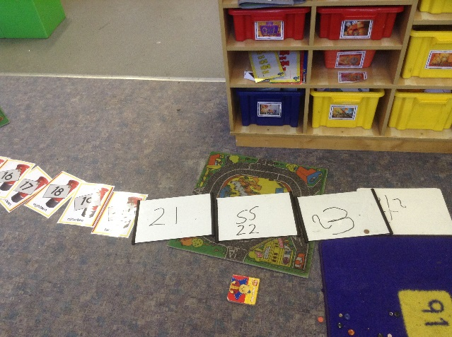
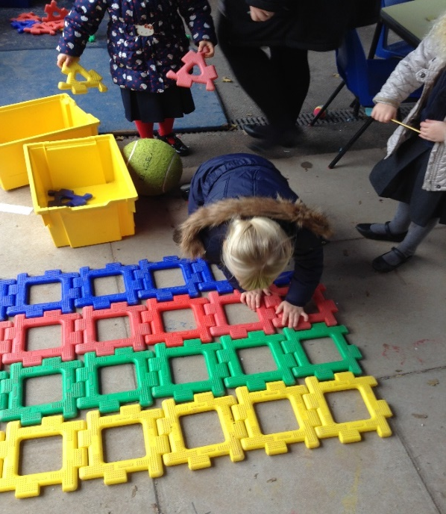
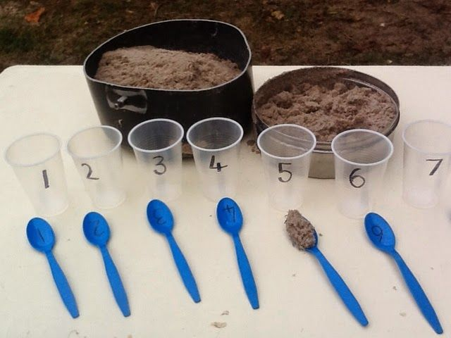
Practical Application of Number

Slide 3
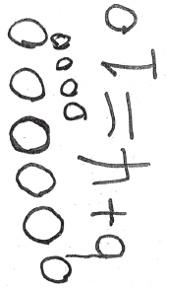
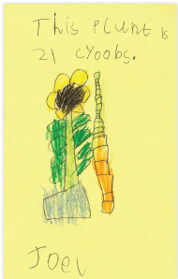
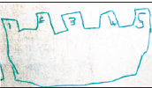
Number
Reciting numbers in order 1-20 (says EVERY number)
Counting reliably – 1:1 correspondence - example of 1:1 correspondence
Recognising numerals 1-10/20 and putting them in order
Knowing one more or one less than a given number
Some examples of number through pictures

Slide 4
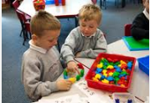

Number
Addition
Adding together two groups of objects to find a total.
Using single digit numbers e.g. 6+4=10
Subtraction/Take away
Taking away from a group of objects

Slide 5
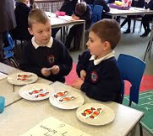
Number
We encourage practical mathematical thinking: Sharing food in the café, cutting fruit in half for their snack, making playdough cakes to share between their friends.

Slide 6
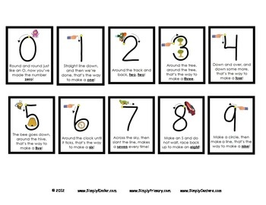
Numeral Formation – very important!

Slide 7

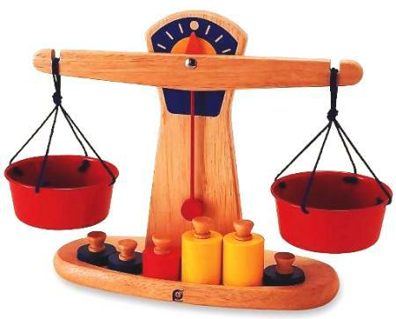

Shape, Space and Measure
Naming 2D and 3D shapes.
Using position words – behind, next to etc.
Describe and create patterns –
Uses everyday words related to size, weight, capacity, time and money.

Slide 8
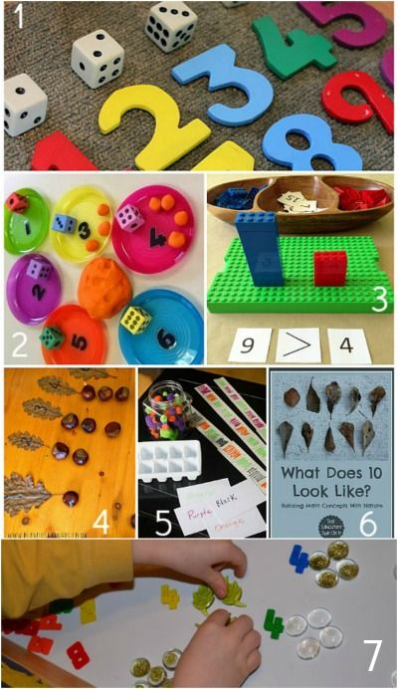
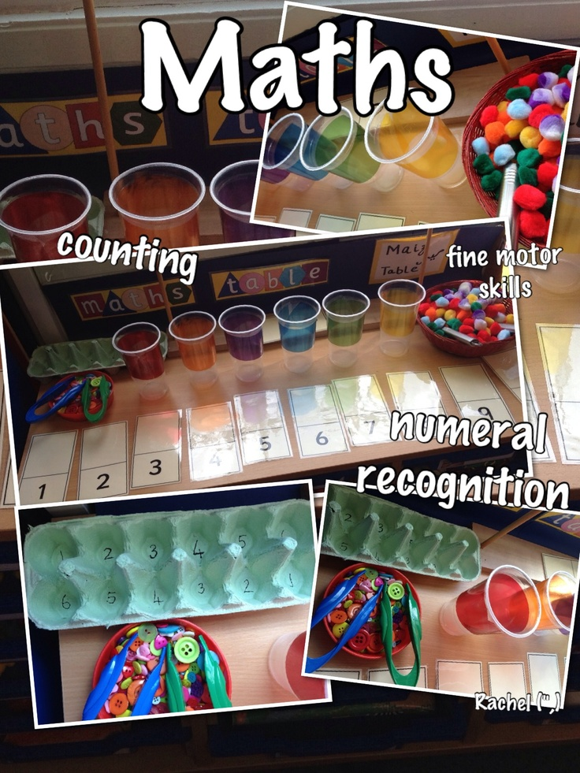
What a good maths day looks like!

Slide 9
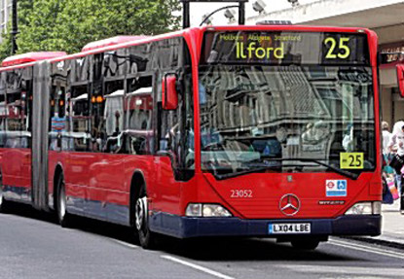
Street Maths
-Recognising bus numbers
-Number plate hunt. Who can
find a 7? Add the numbers up.
-Comparing door numbers
-Counting – How many lamp posts on the
way to school?

