Slide 1
Literacy Information

Slide 2
In the English language we need to learn 44 sounds (phonemes) using just 26 letters (graphemes).
We teach pure sounds not letter names
By pure sounds we mean s a t not S A T

Slide 3
Phase 2
Sounds are introduced in sets
Set 1: s a t p
Set 2: i n m d
Set 3: g o c k
Set 4: ck e u r
Set 5: h b f ff l ll ss

Slide 4
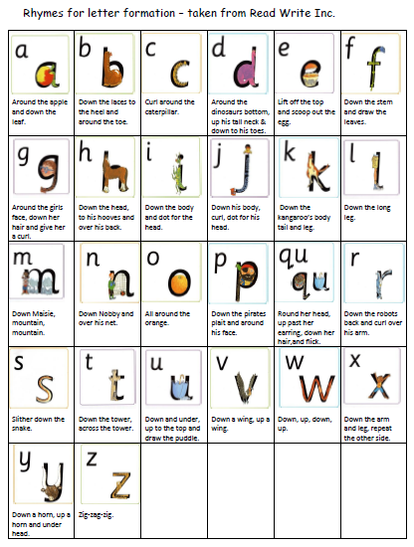
Single Sounds - Rhymes
We use rhymes to help the children remember how to form the letter.
For example, a is:
“ Around the apple, down the leaf.”

Slide 5
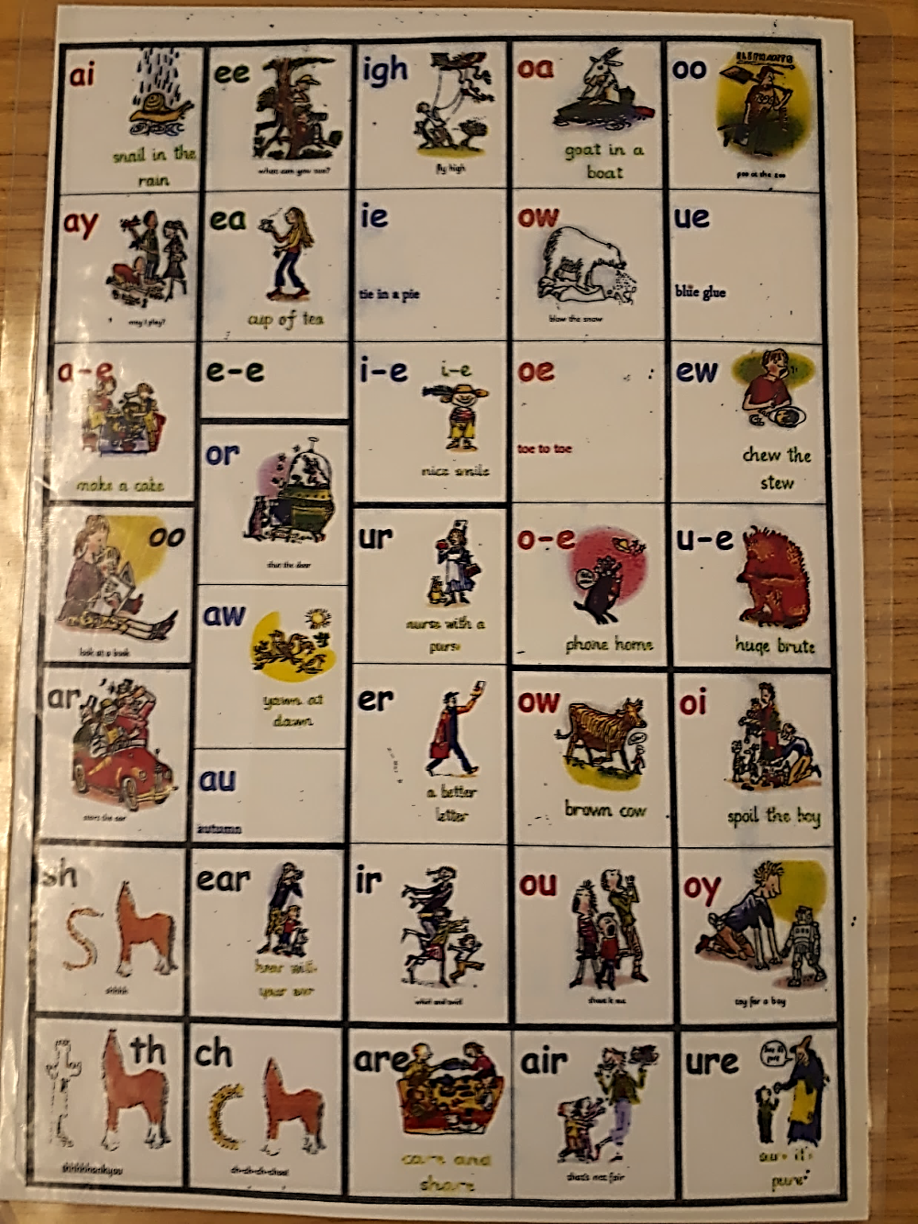
Digraphs - Rhymes
Digraphs are sounds made from 2 letters paired together.
For example, ‘ai’ in rain.
We also use rhymes to help the children remember the digraphs.
For example, ‘ai’ is ‘snail in the rain’.

Slide 6

Tricky words
Your child will also learn sight words. The red ones are known as tricky words as they cannot be sounded out.
a | is | dad | him | but
an | it | had | his | put
as | of | back | not | the
at | off | and | got
if | on | get | up
in | can | big | mum
will | see | he | you
that | for | she | they
this | now | we | all
then | down | me | are
them | look | be | my
with | too | was | her
went | said | come | out
it’s | have | were | what
from | like | there | to
children | so | little | I
just | do | one | no
help | some | when | go

Slide 7
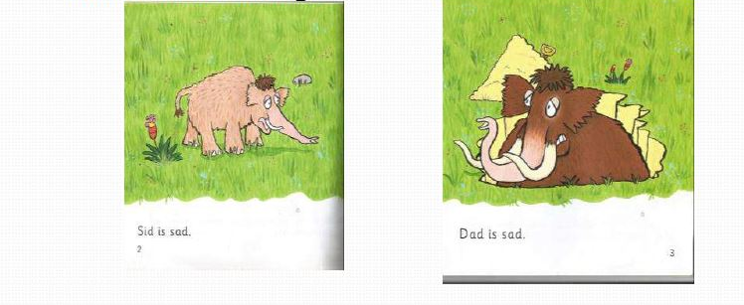
BLENDING
We teach the children to blend sounds together to make real words; “Look at the letter, say the sounds and blend the sounds together.”

Slide 8
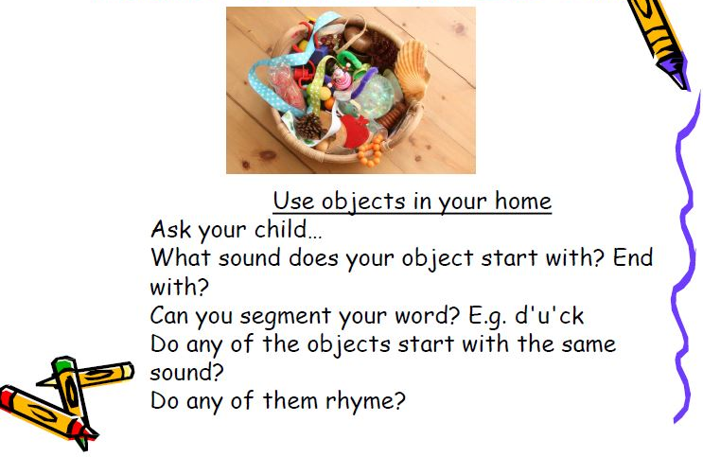
How can I help at home?

Slide 9
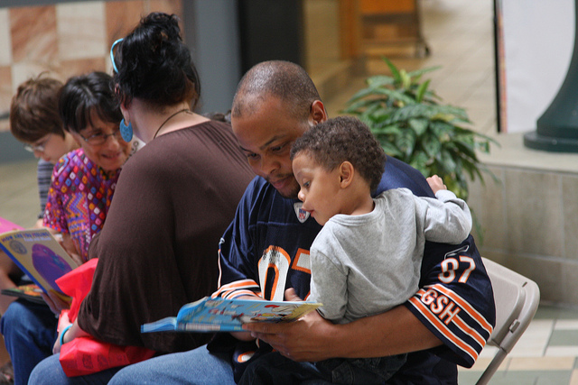
Please listen to your child read at least 4 times a week.

Slide 10
Two reading books
Each week your child will take two reading home.
PM book and a phonics based book.
BOTH are as important as each other

Slide 11
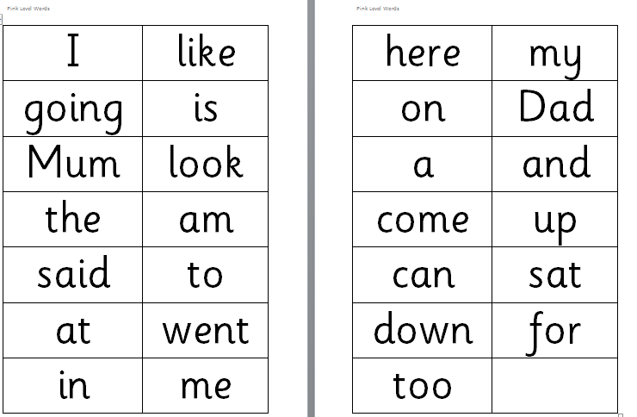
Sight Words

Slide 12
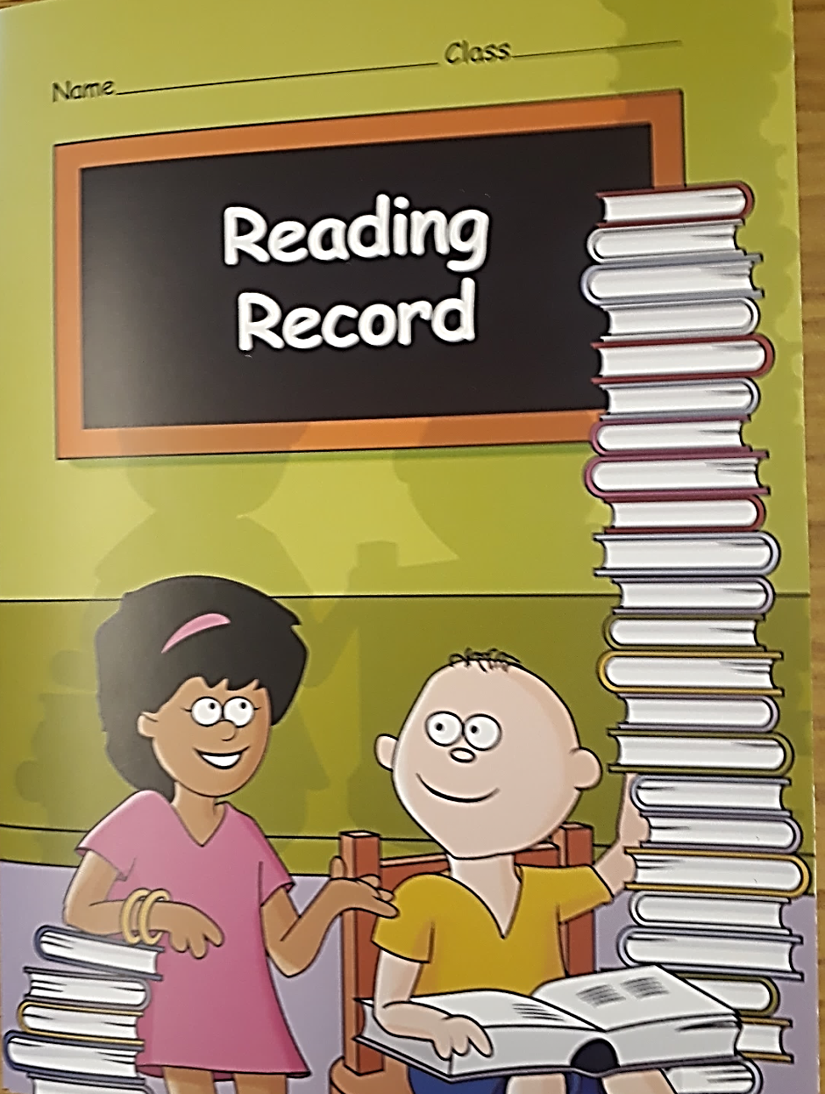
Reading Record
Your child will be given a reading record. It is very important to record how often your child is reading with you at home.
How often your child reads will be regularly monitored by staff.

Slide 13
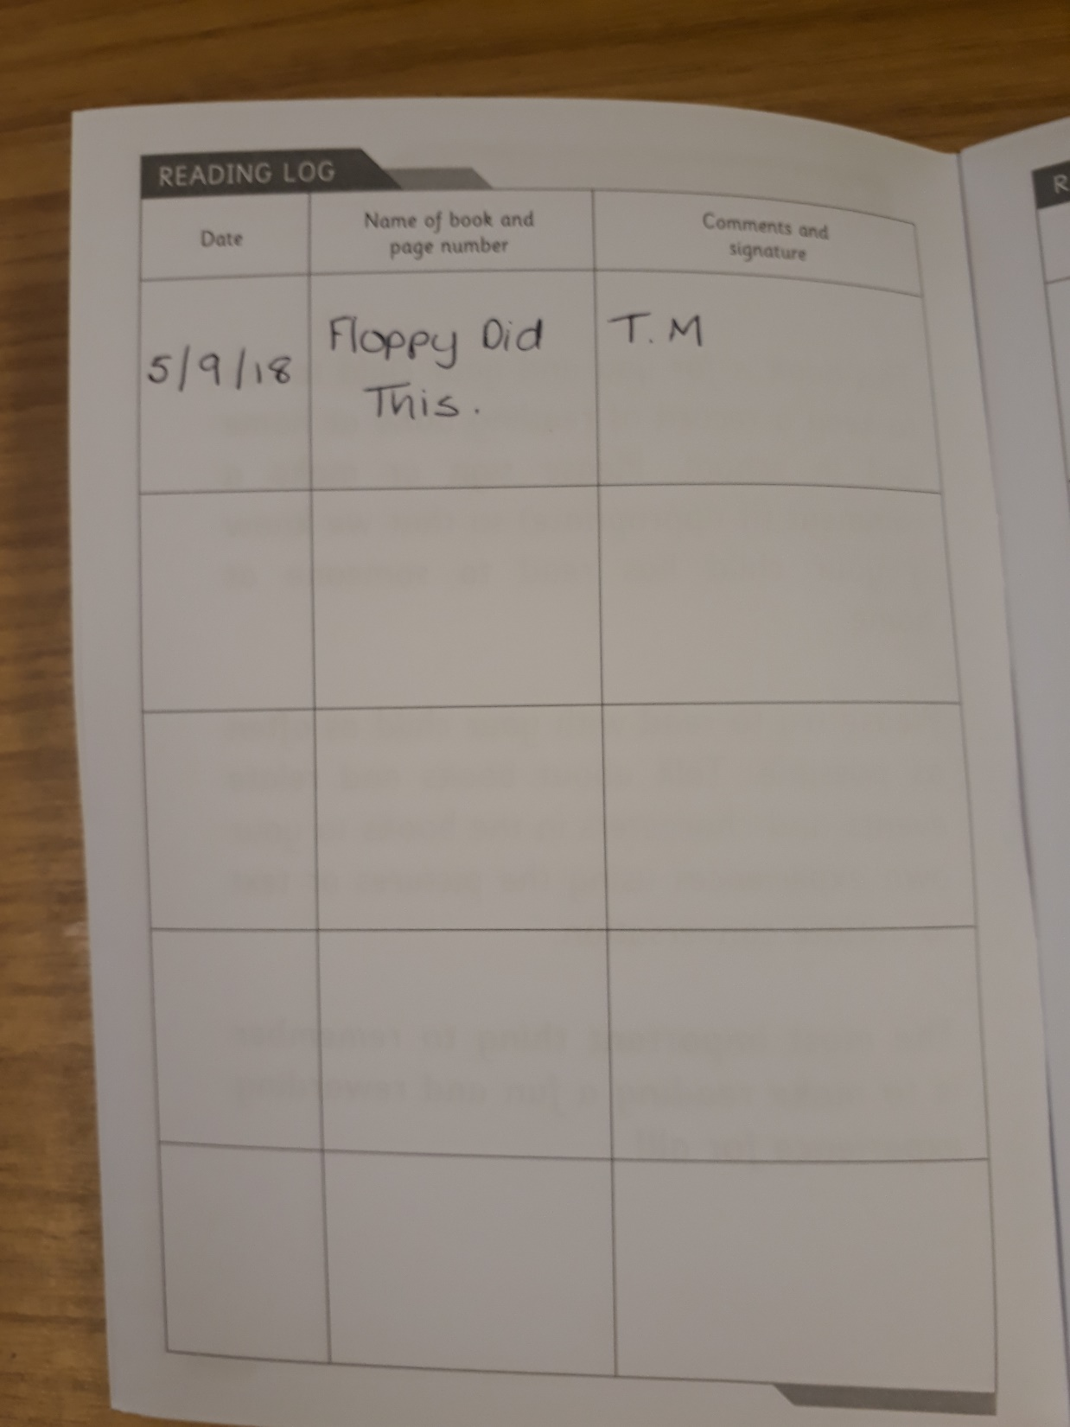
The record can be really simple, put the date, title and initials, that’s all you need!

Slide 14
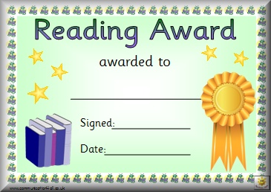
Reading Certificate
If your child reads more than 4 or more times a week they will receive a certificate to congratulate their achievement.

Slide 15
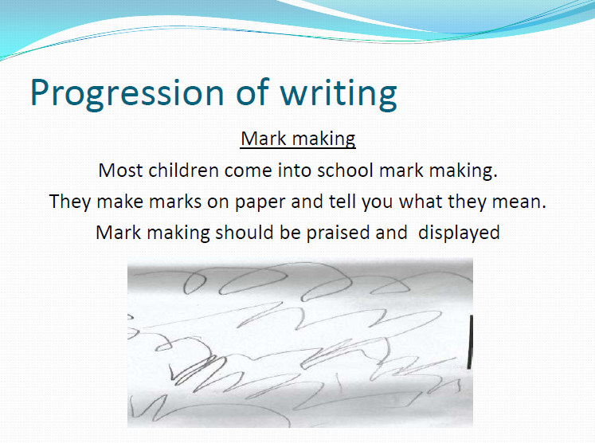

Slide 16
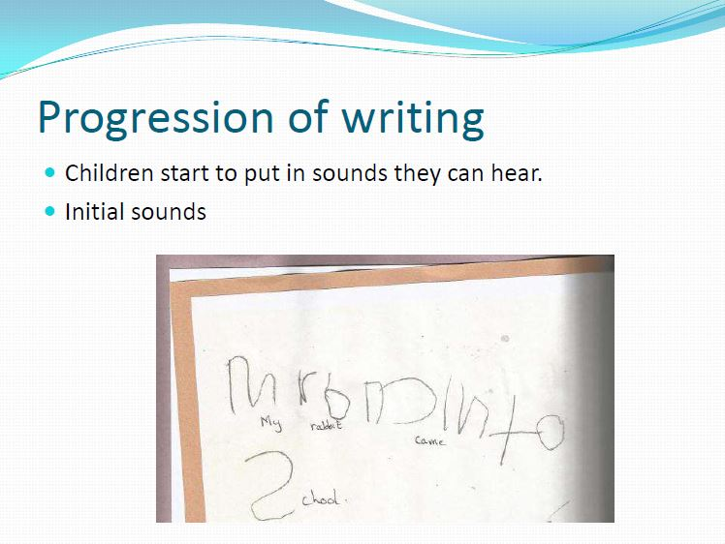

Slide 17
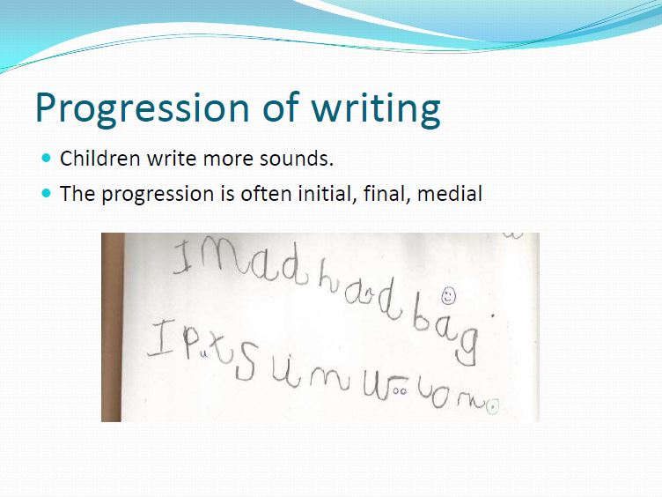

Slide 18
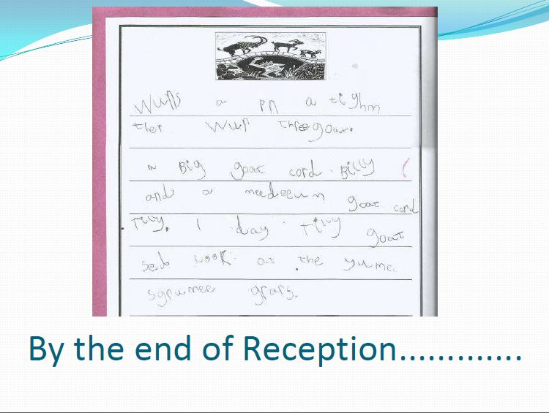

Slide 19


