Slide 1
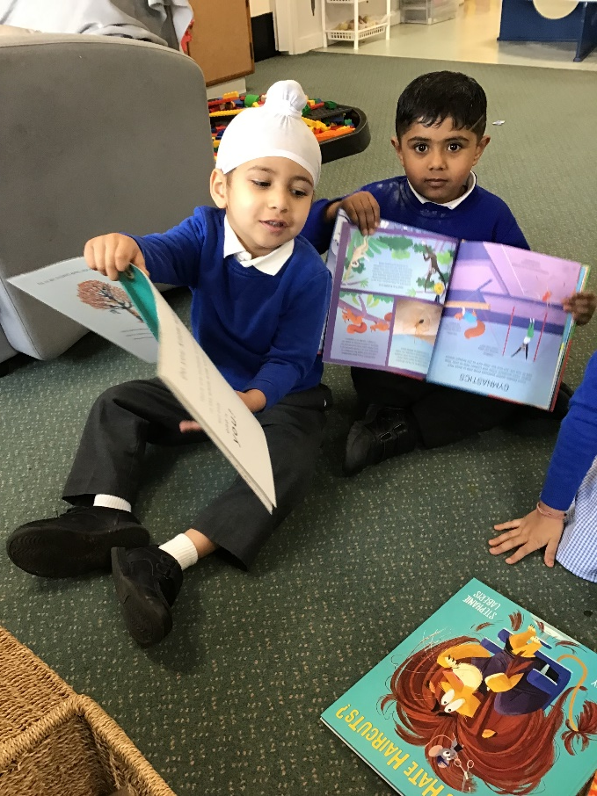
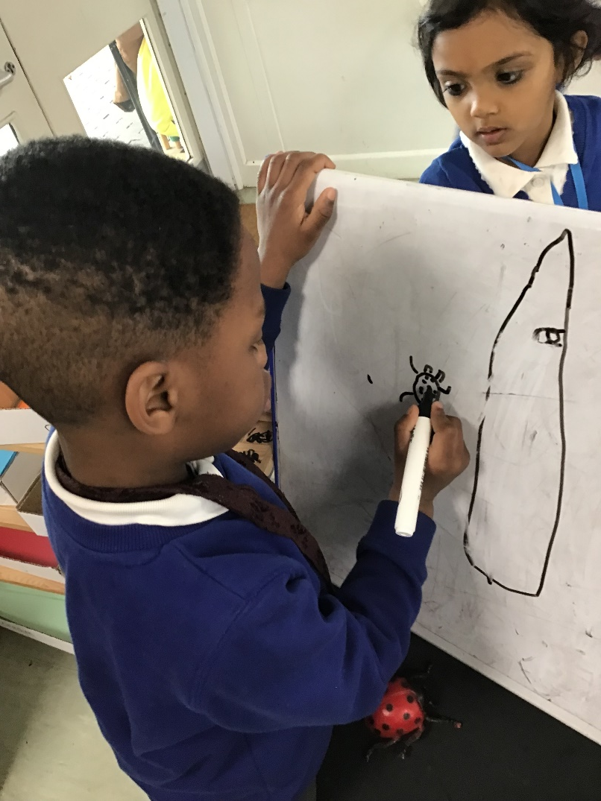
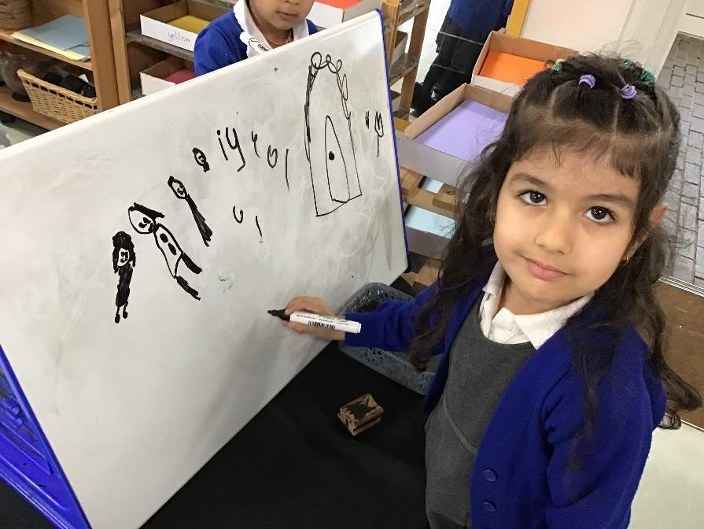
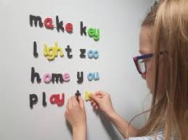
Literacy in F2
Reading
Writing
Phonics
Speaking and Listening

Slide 2
Ways to help your child…
1. Talk, talk, talk!
2. Talk about the pictures in books, the people or characters – their feelings and actions, guess what’s happening before turning a page.
3. Read to your child – in any language to model what to do.
4. Share a book with them to guide and help.
5. Sing!
6. Pronounce words and sounds clearly.
7. ‘I spy’ games that use the first sound.

Slide 3
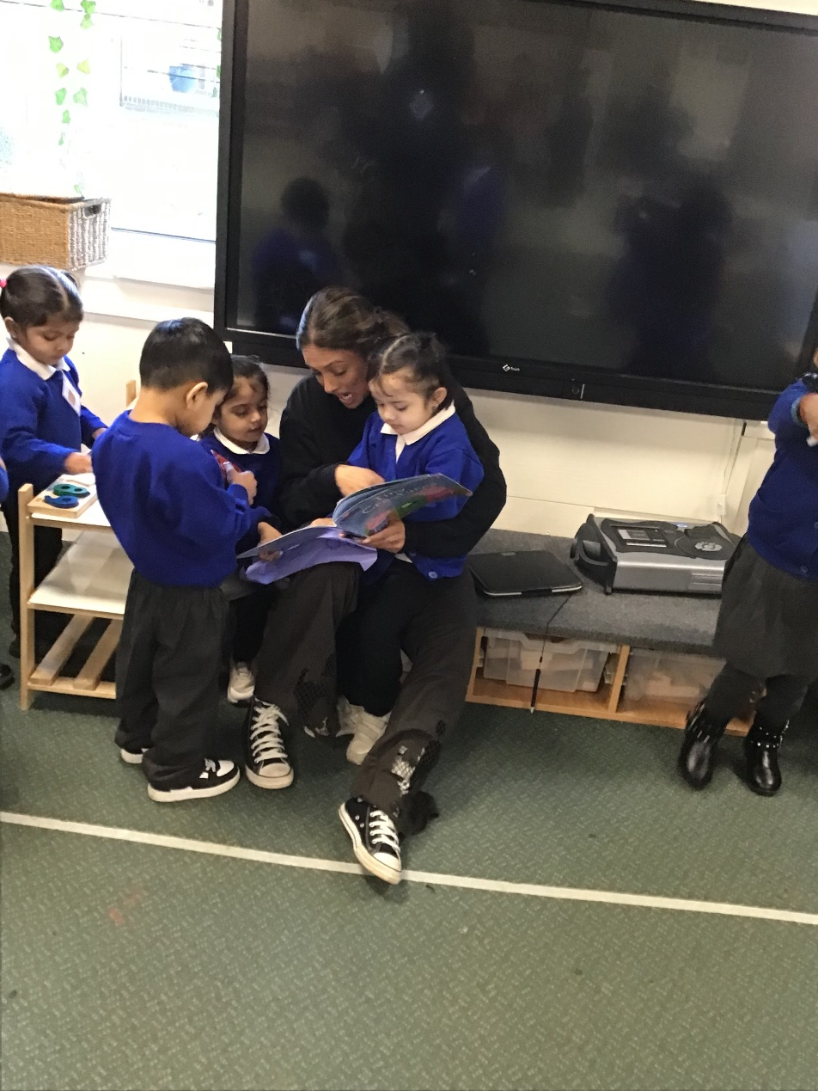
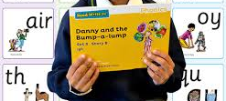
Types of reading.
Reading for pleasure books.
School books practise sounds, words, sentences and story structure.

Slide 4
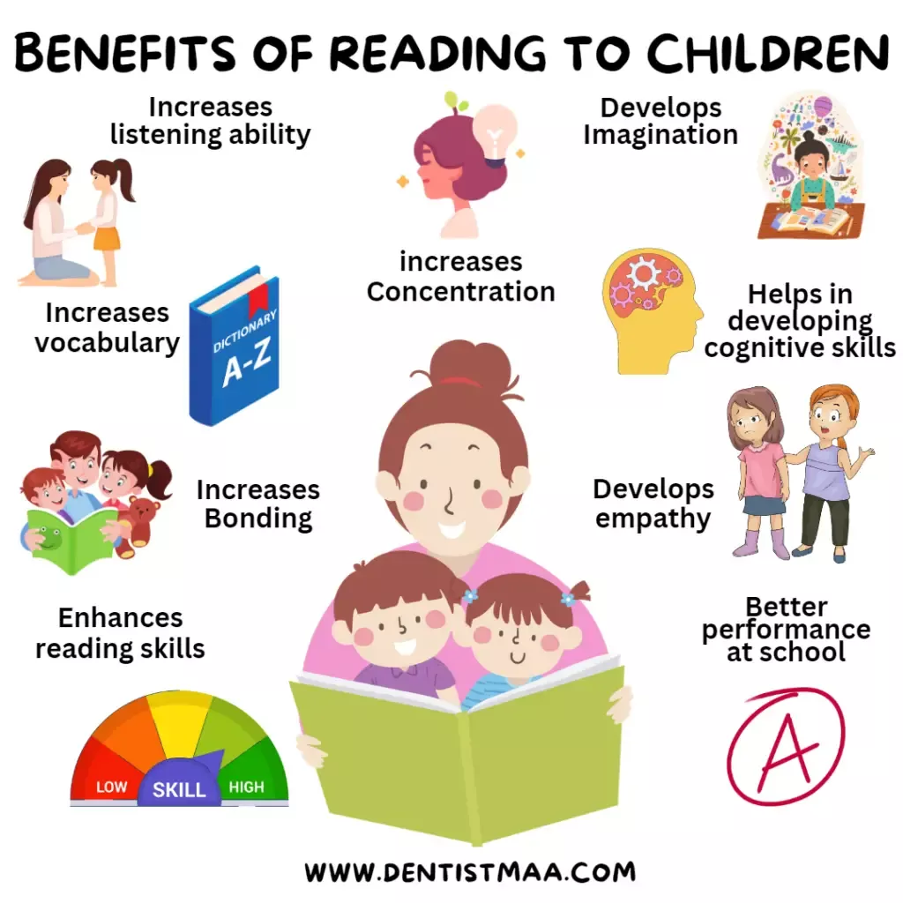
Reading for pleasure.
Let your child choose and give them control!
Go to the library as often as you can.
In school we have a variety of books in the classrooms.
We have competitions.
We vote.
We read stories every day and talk about them.
We repeat stories.

Slide 5
How do we learn to read in school?
We learn the alphabet sounds first and then combinations of groups of 2 and 3 sounds.
ay ee are air – these are called SPECIAL FRIENDS.
We blend words together. These are called GREEN words.
We practise reading words that can’t be sounded out. These are called RED words.

Slide 6
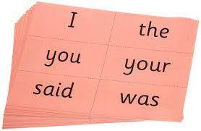

Red words.
Your child will also learn RED words. The RED words are known as ‘at a glance’ words as they can’t be sounded out and must be learned by rote.

Slide 7
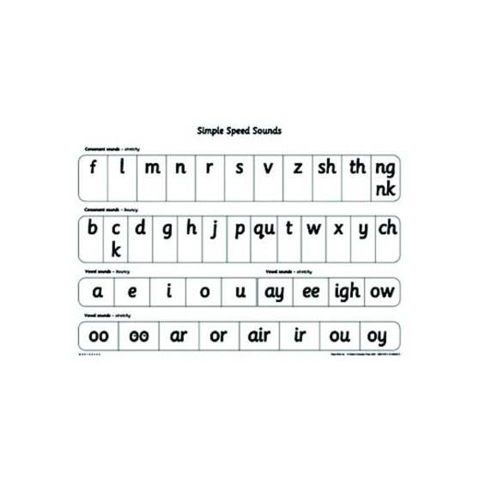
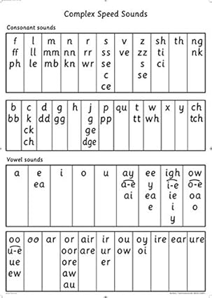

Slide 8
Phonic Sounds.
Go to …
Merrydale Infants website using google.
Children (heading).
Phonics (heading).
How to teach blending video.
PLEASE PRACTISE SOUNDS RATHER THAN LETTER NAMES.

Slide 9
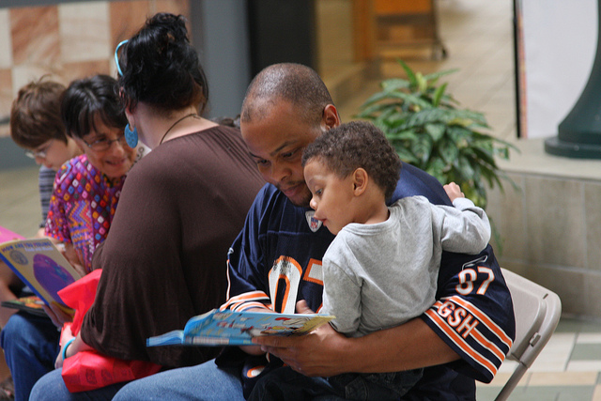
Please listen to your child read at least 4 times a week.
x1 10 mins a week
520 mins a year.
1560 x3 years.
x4 40 mins a week
2080 mins a year.
6240 mins x3 years.

Slide 10
Reading books.
Each week your child will come home with reading cards/books or ditties which are short sentences.
Please record this in their reading record book.
Adults will look at it and give your child a certificate.

Slide 11
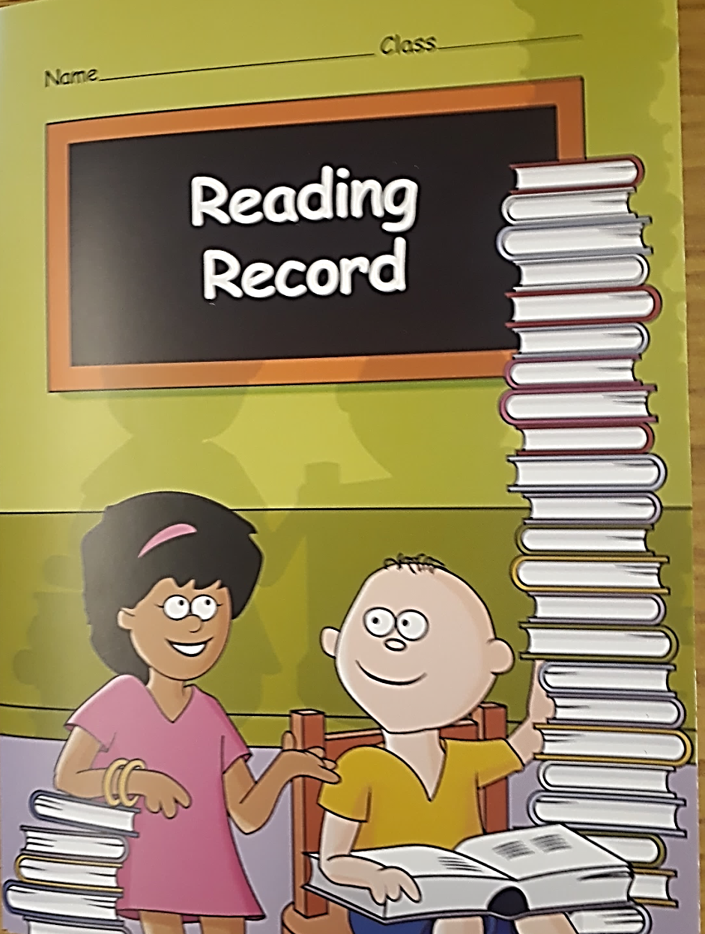
Reading Record.
Your child will be given a reading record. It is very important to record how often your child is reading with you at home.
How often your child reads will be regularly monitored by staff.

Slide 12
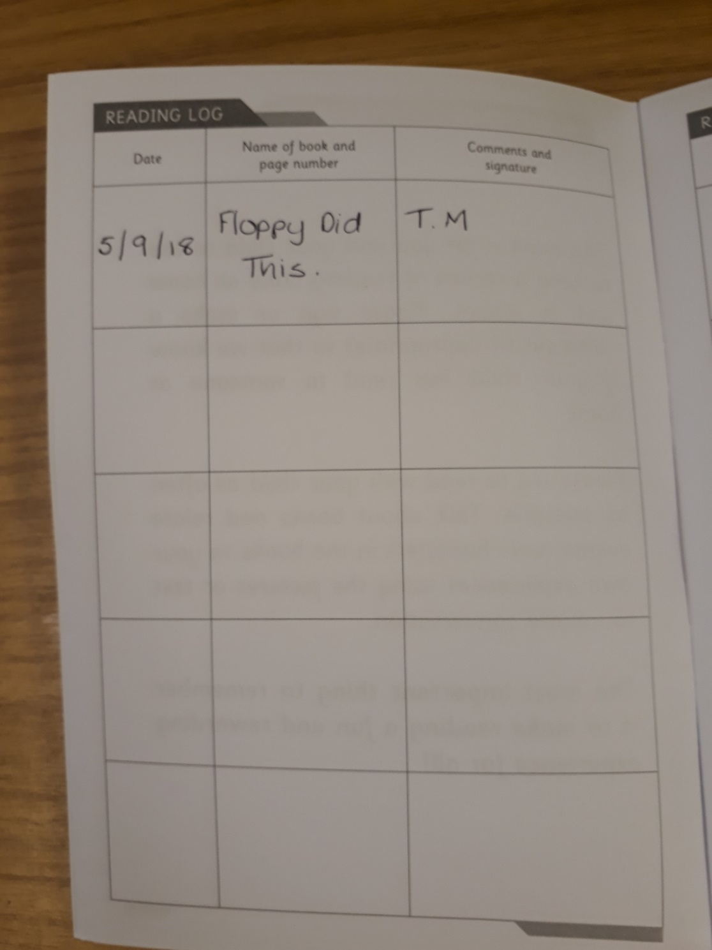
The record can be really simple, put the date, title and initial, or a

Slide 13
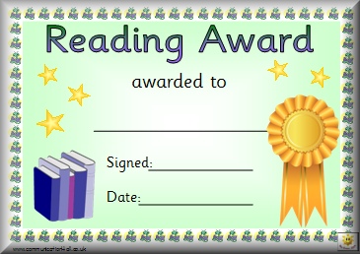
Reading Certificate.
This is to congratulate their achievement.

Slide 14
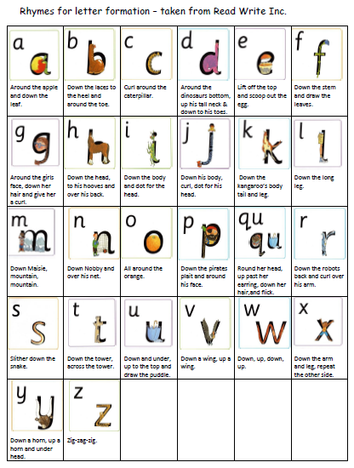
How do we learn to write in school?
We use rhymes to help the children remember how to form the letter.
A is:
“ Around the apple, down the leaf.”

Slide 15
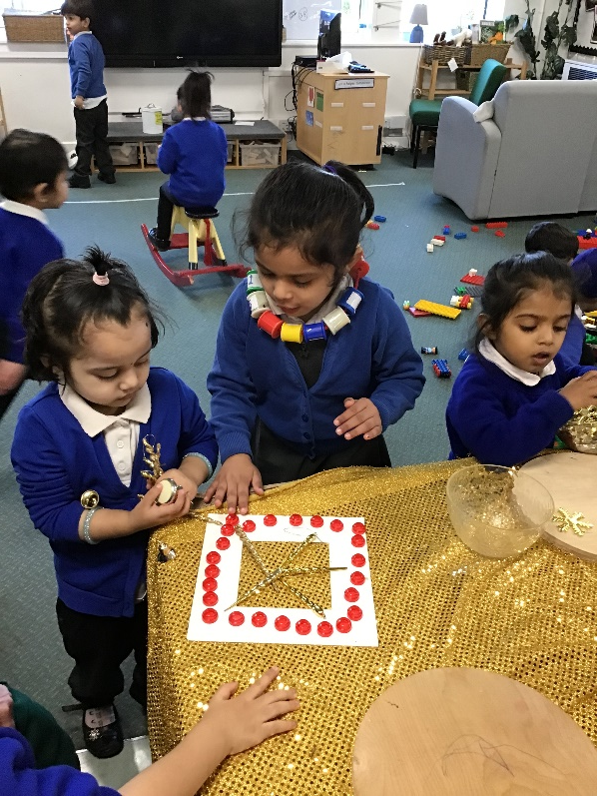
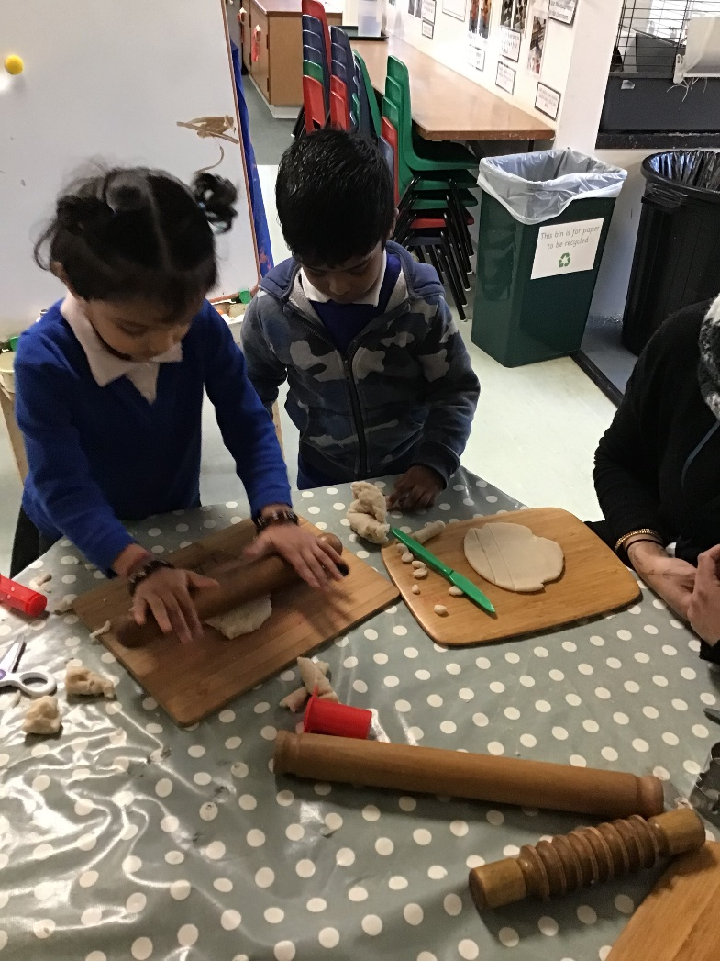
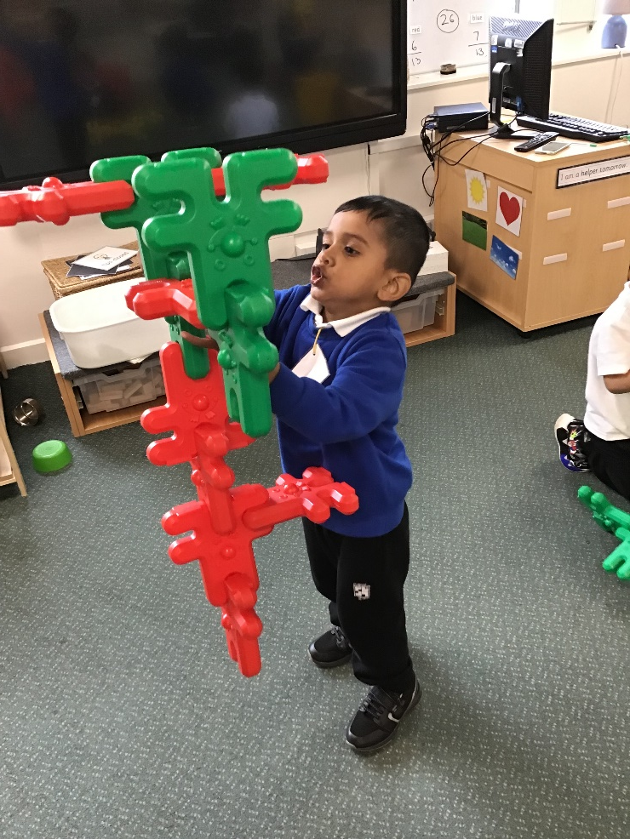
Pencil Grip Activities.

Slide 16
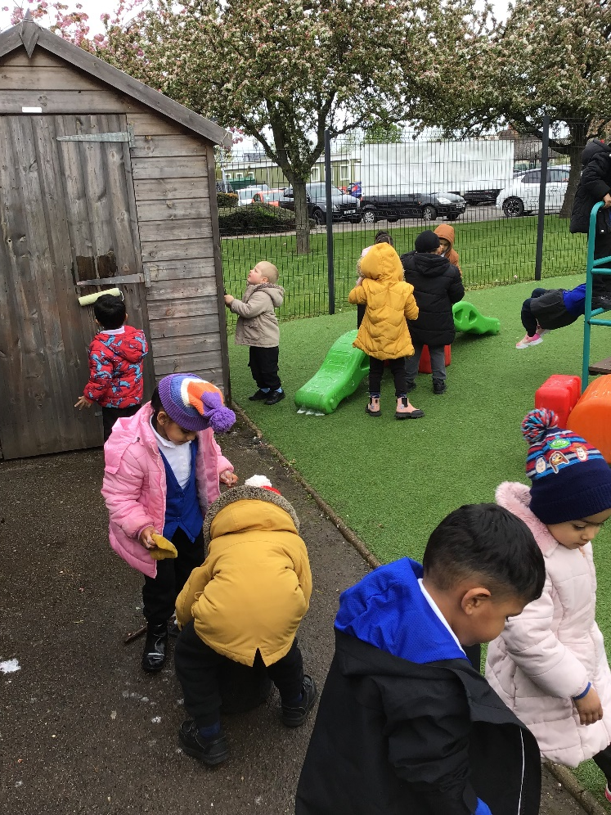
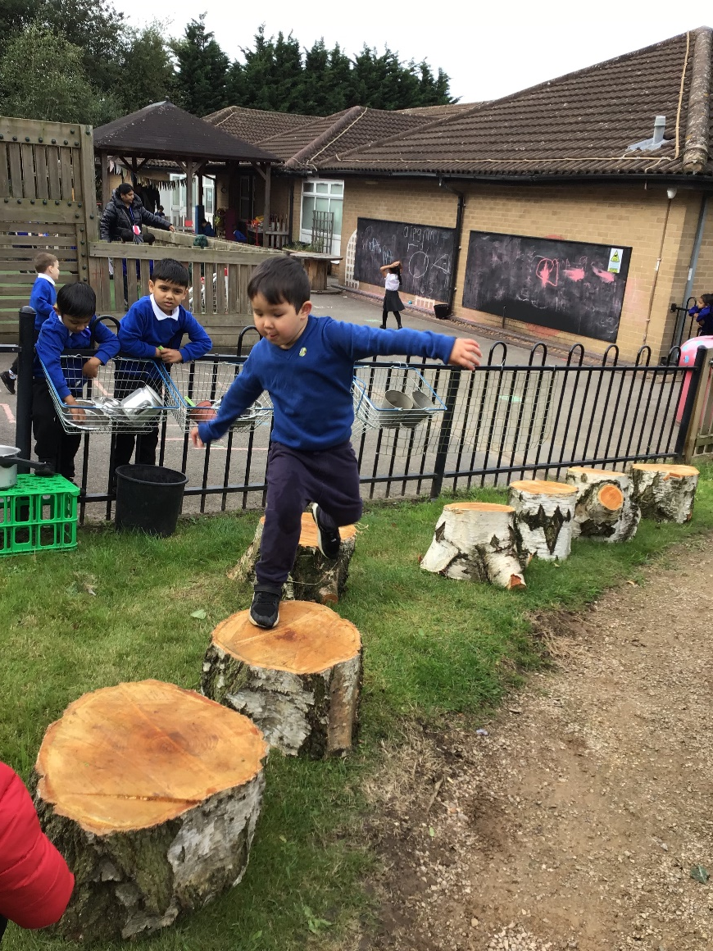
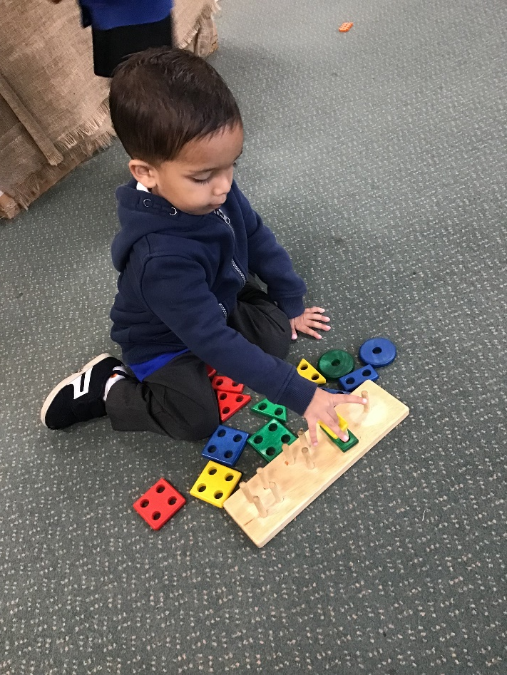

Slide 17
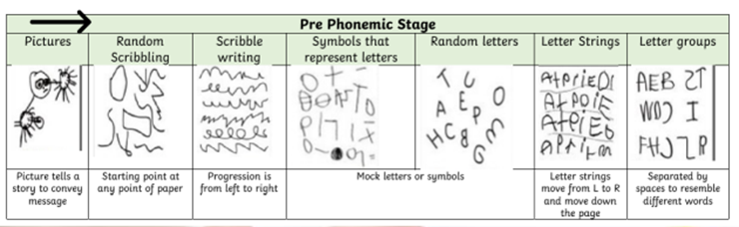
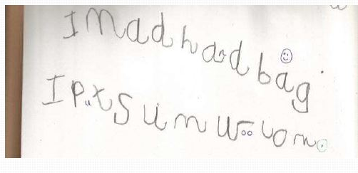
How will writing change?

Slide 18
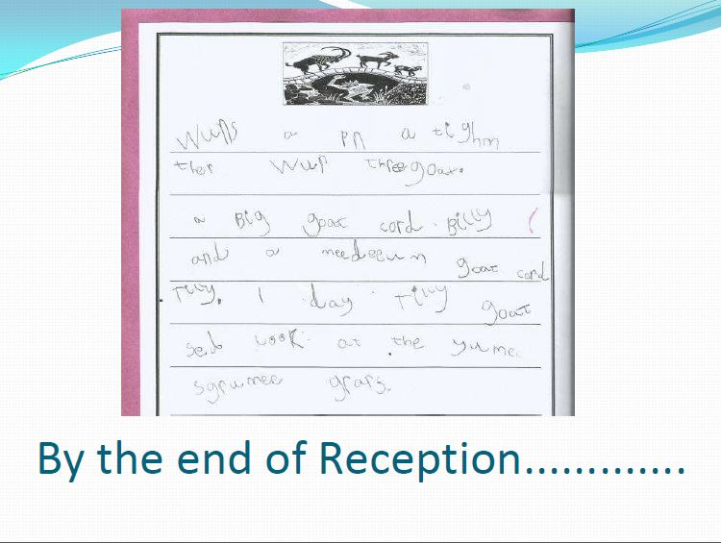
By the end of F2…

