Slide 1


Slide 2
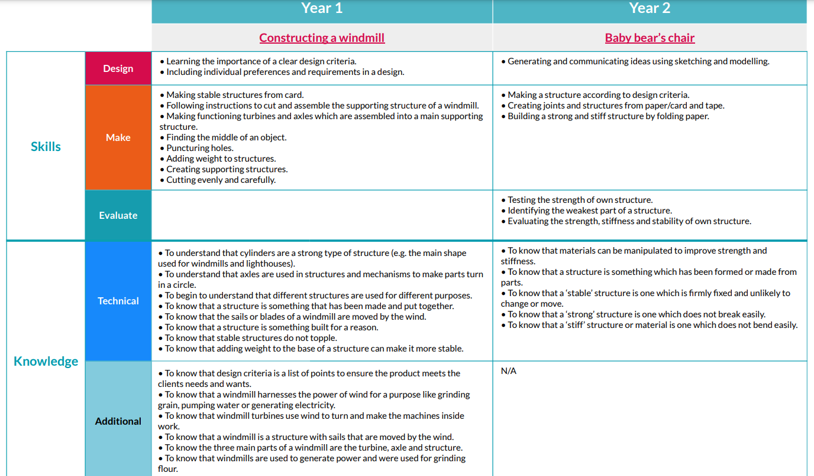
Structures
Year 1
Year 2
Towers
Baby bear’s chair
To use basic drawing skills to communicate ideas.
To say what they are going to make and why.
To design their product with a user in mind. Begin to consider their like/dislikes.
To design a product to suit the needs of their ‘client’.
To generate and communicate ideas by drawing, writing and labelling.
To use scissors competently, confidently and with growing accuracy.
To cut large shapes and thicker materials, such as card.
To choose between a small number of materials.
To make a stable structure according to agreed design criteria.
To make different parts of a structure by strengthening paper in different ways (E.g. folding, rolling, layering, etc.)
To join part of a structure in different ways (adding layers of tape, cutting tabs and then taping
To discuss existing products, saying what they like and/or dislike about them.
To say what they like about a peers’ designs and products.
To accept feedback, understanding it is meant to improve their work.
To test and evaluate the stability of different shapes.
To evaluate the strength, stiffness and stability of their structure.
To explore the features of ‘real life’ structures in the outside world.
To test and evaluate the stability of their own structures.
Know that stable structures do not topple over.
Know that structures with wide, flat bases are more stable.
Know that a structure is a building or freestanding object..
Know that weight can be added to the base of a structure to make it more stable..
To know that structures with wide, flat bases or legs are the most stable.
To know that materials can be manipulated to improve strength and stiffness.
To know that a stable structure is one which is firmly fixed and unlikely to change or move.
To know that a strong structure is one that does not break easily.

Slide 3
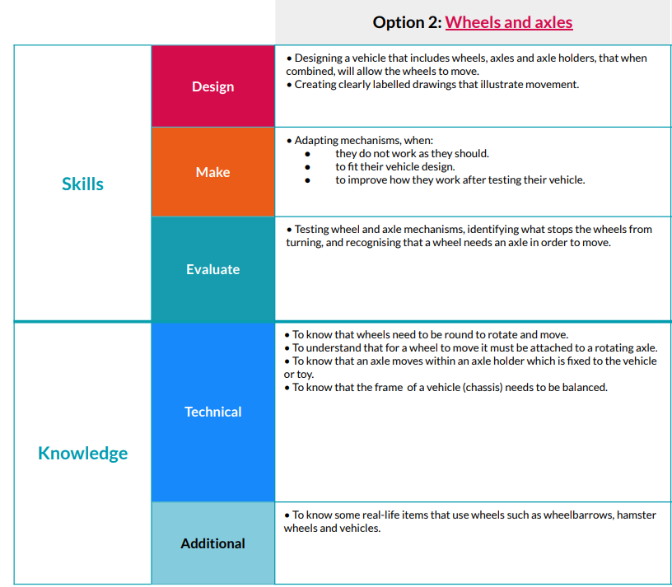
Mechanisms/
mechanical systems
Year 1
Wheels and axles
Create clear drawings, labelling with appropriate vocabulary. E.g. chassis, axle, wheel.
To fix axles an appropriate distance apart using tape/glue to join axle holders to a chassis.
To adapt wheels/axles to improve performance.
To test their wheel and axle mechanisms, identifying what stops it from turning well.
To suggest improvements to their peers’ models.
Know that the frame of a vehicle is called a ‘chassis’.
Know some real-life items that use wheels, such as cars, trolleys, toys, etc.

Slide 4
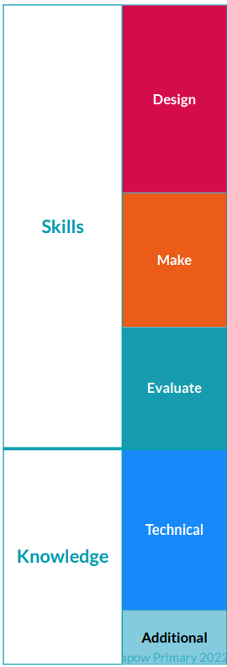
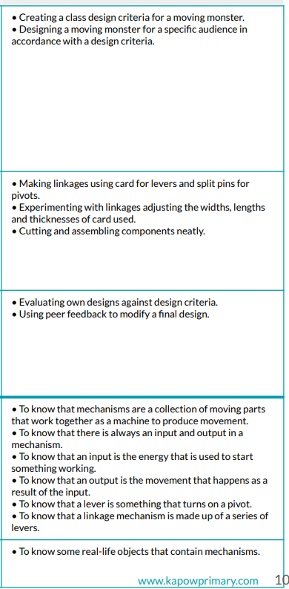
Year 2
Mechanisms/
mechanical systems
Making a moving monster
To make own holes for split pin pivots using a sharp pencil and a rubber.
To make slider mechanisms by making their own cuts to a piece of card and inserting a lever.
To know that there are different mechanisms, including ‘pivot/lever’ and ‘sliding mechanisms’.

Slide 5
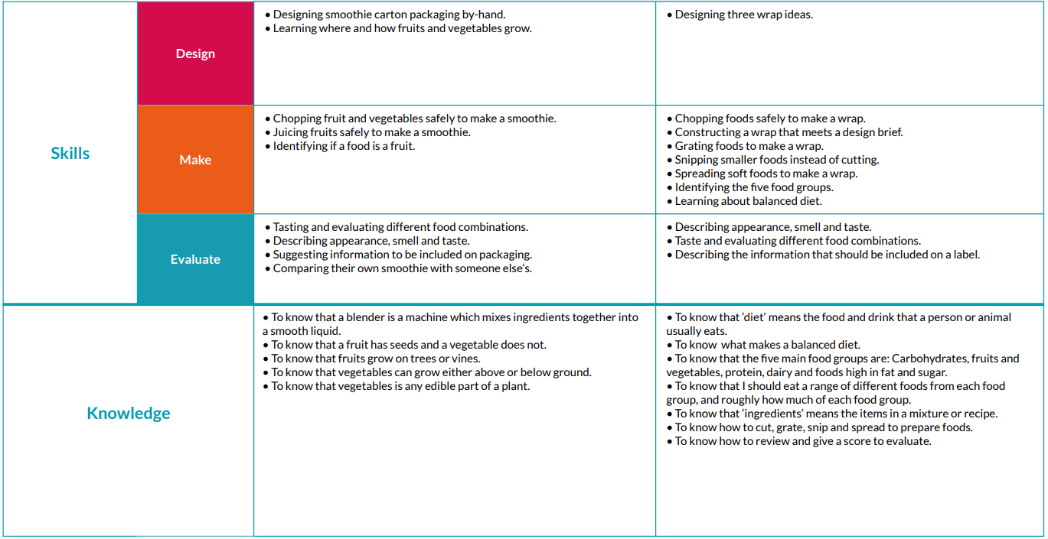
Cooking and nutrition
Year 1
Year 2
Smoothies
Balanced diet
To choose 3 ingredients, froma small selection, to create a recipe.
To create a design for a smoothie carton by drawing on, and adding colour to, a template.
To design 2-3 different healthy wraps with balanced ingredients.
To cut and chop softer ingredients safely, using the ‘bridge’ grip.
To use a juicer to extract the juice from citrus fruits.
To cut and chop ingredients safely, using the ‘bridge’ and/or ‘claw’ grip.
To grate ingredients safely using a box grater.
To snip smaller, thinner ingredients, such as herbs, into smaller pieces using scissors.
To spread soft foods, such as cream cheese and hummus, using a spoon or knife.
To taste and evaluate different food combinations, commenting on taste, smell and appearance.
To compare their own smoothie with someone else’s, commenting on good points and improvements.
To taste and evaluate different food combinations, commenting on taste, smell and appearance.
To compare their own smoothie with someone else’s, commenting on good points and improvements.

Slide 6
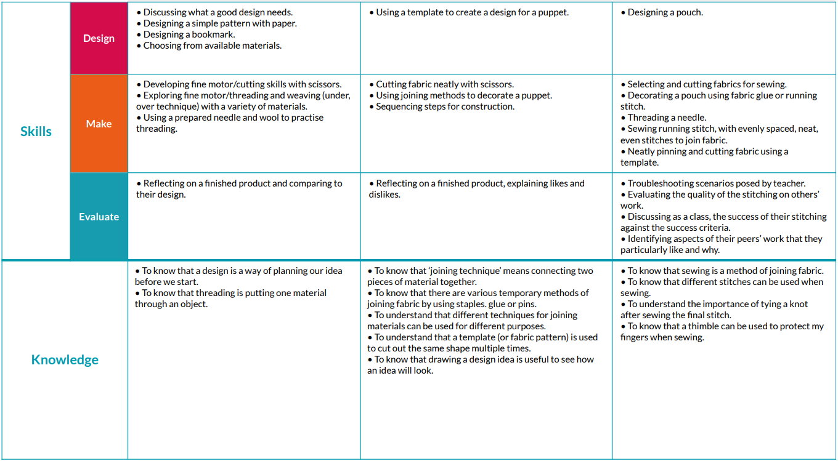
Textiles
Year 1
Year 2
Puppets
Pouches
To create multiple designs for the decoration of a pouch, using a template.
Selecting and cutting fabric for joining.
Decorating a pouch using fabric glue.
To use safety pins to temporarily join fabric.
To cut fabric accurately using a fixed template to help.
To join two pieces of textiles by using a stapler.
To add staples at regular intervals.
Begin to use safety pins to temporarily join fabric.
To join pieces of fabric using fabric glue.
To identify aspects of their peers’ work that they like, stating why.
To evaluate the quality of finishing on their own work, and that of others’.
To know that there are various methods of joining fabric, such as: staples, glue and pins.
To know that using glue is better for joining small pieces of fabric to decorate their pouch.
To know that there are various methods of joining fabric, such as: glue and pins.

